Slide 1


Lateral thinking
Help everyone to learn faster

Slide 2

Tujuan pembelajaran:
- berpikir lateral
- contoh berpikir lateral
Help everyone to learn faster

Slide 3
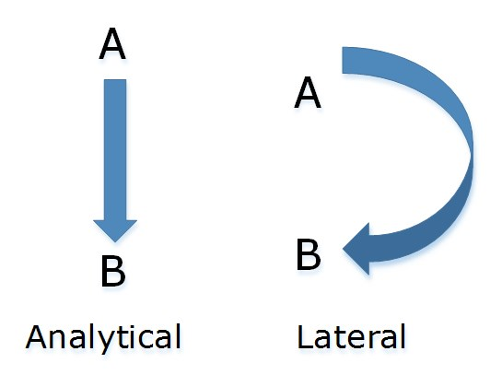
Lateral thinking
Help everyone to learn faster

Slide 4
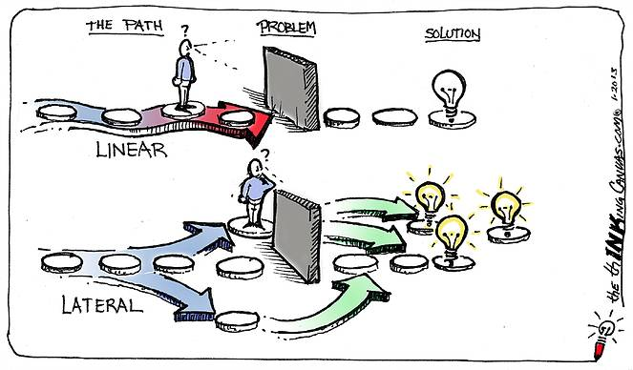
Help everyone to learn faster

Slide 5
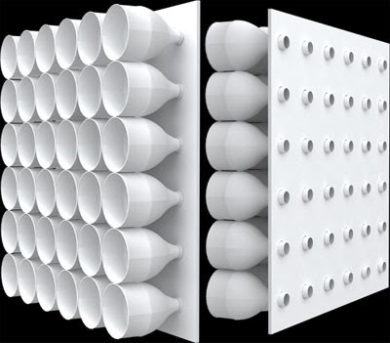
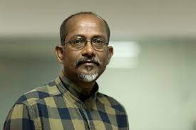
Contoh lateral thinking
Ashis Paul
Help everyone to learn faster

